Slide 1


DON’T COMPROMISE.
Introduction to Racktivity
for
DON’T COMPROMISE
DCPM presentation

Slide 2
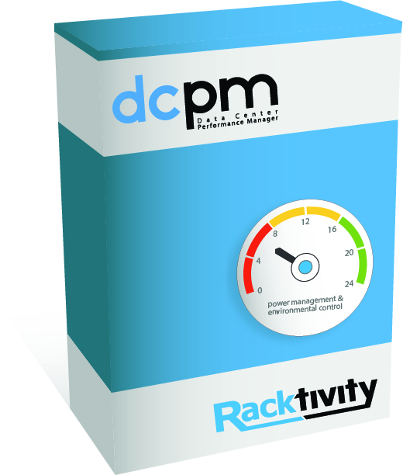

.what?
The ultimate software to
monitor
visualize
control
automate
your power & environmental parameters
DON’T COMPROMISE - reliable power management & environmental control
All content of this presentation is strictly confidential

Slide 3


.why DCPM?
Maximize your power & environmental efficiency
Increase the reliability & uptime of your facility
Reduce your OPEX & carbon footprint
DON’T COMPROMISE - reliable power management & environmental control
All content of this presentation is strictly confidential

Slide 4

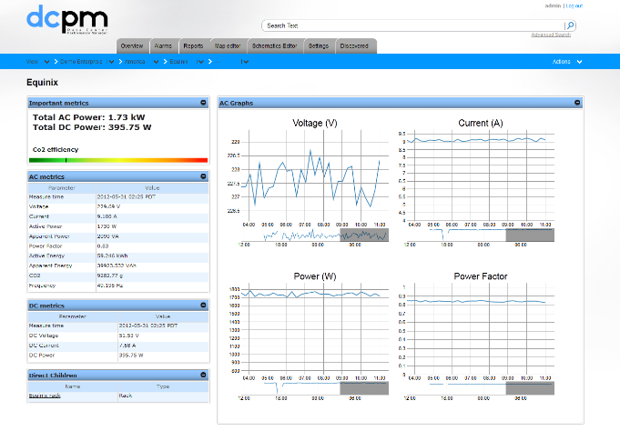
.how do we do this?
Through a web-based user interface
By offering a global view allowing you to drill down to the individual power outlet or measurement point and everything in between, providing you with a clear and complete view of your energy usage
DON’T COMPROMISE - reliable power management & environmental control
All content of this presentation is strictly confidential

Slide 5

.DCPM - features
Collection of power environmental and other data
Collection of billing data
Visualization of data on maps, graphs and logical views
Visualization of trends and historical data
Customized grouping
Different aggregation levels
Time related aggregation
Capacity monitoring
Power usage efficiency
Event notification
Event handling
Customized alarms
Monitoring alarms
Trending alarms
Periodic alarms
Total cost of ownership
Power usage forecasting
Power usage of redistribution of applications on server
Impact of temperature changes in efficiency
^{MONITOR}
^{ALARM}
^{SIMULATE}
Easy integration with third party reporting solutions such as Business Objects, Crystal reports...
Extensive logging possibilities
Firmware upgrades
Automated servers
start-up
Cooling control
Gracefull shutdown
^{REPORT}
^{AUTOMATE}
Power usage effectiveness
Capacity
Power & environmental trends
Alarm history
Seasonality
^{ANALYSE}
Remote reboot & graceful operational shutdown
Remote control of visual and auditory alarms
^{CONTROL}
DON’T COMPROMISE - reliable power management & environmental control
All content of this presentation is strictly confidential

Slide 6
.DCPM Installation
Installation needs to be done on a Linux OS system
Ubuntu
Debian
Cent OS
...
Latest DCPM version is available on an FTP server.
Installing DCPM requests
Enterprise name
SNMP information
SMTP information
Company Location information / Licence key when more than 2 components
Contact information
DON’T COMPROMISE - reliable power management & environmental control
All content of this presentation is strictly confidential

Slide 7
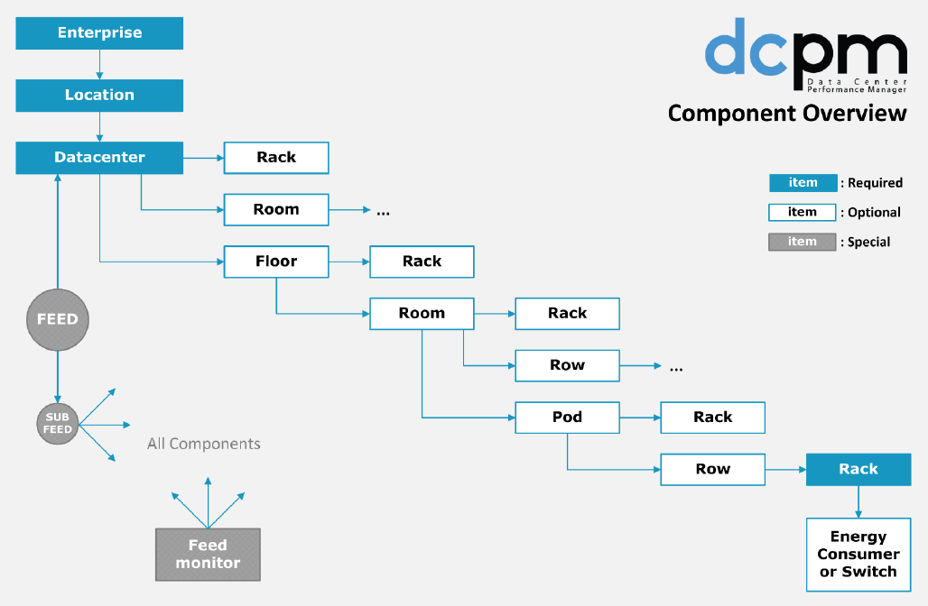
.Create structure in DCPM
The enterprise stucture needs to be set up into DCPM.
DON’T COMPROMISE - reliable power management & environmental control
All content of this presentation is strictly confidential

Slide 8
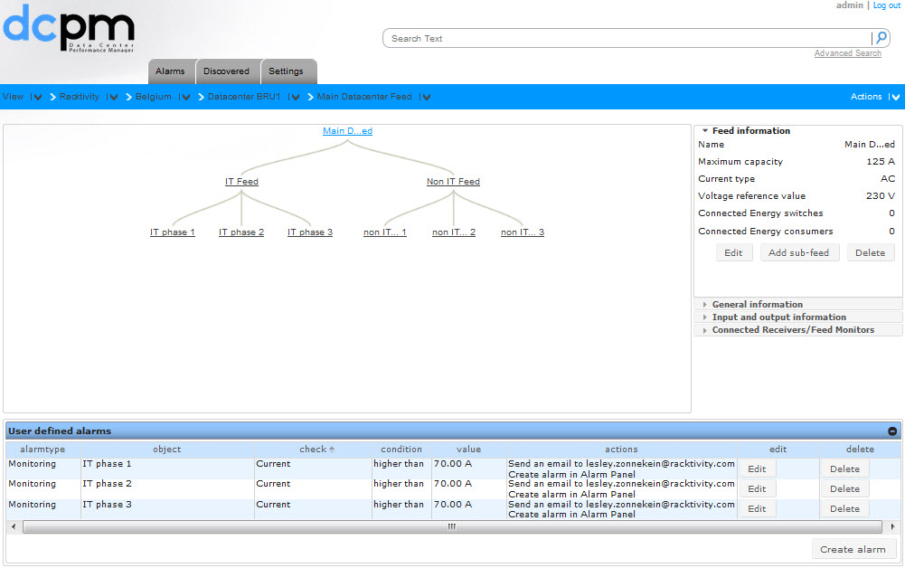
.Create feeds in DCPM
When the datacenter is created you can add feeds and subfeeds.
Energy consumers can be attached to the feed in order to perform capacity planning.
DON’T COMPROMISE - reliable power management & environmental control
All content of this presentation is strictly confidential

Slide 9
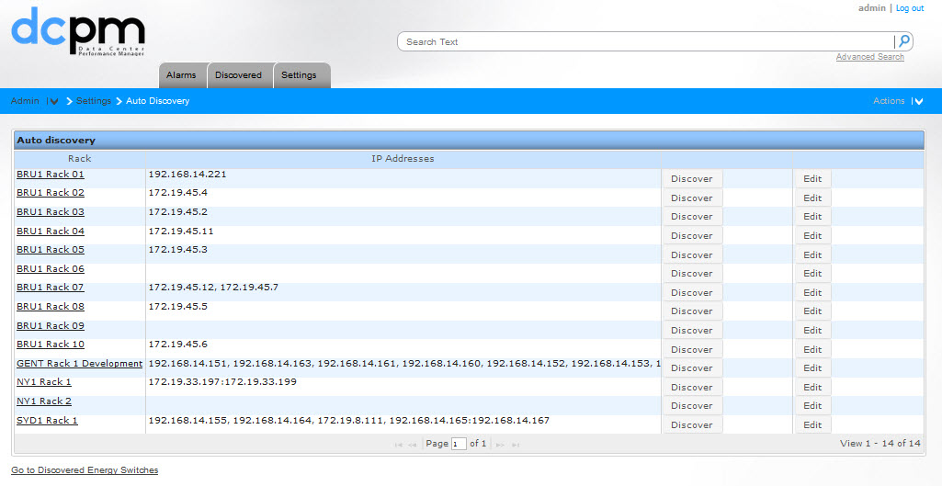
.DCPM adding devices
Adding Racktivity or third party energy consumers can be done trough a simple auto discovery tool by adding the IP address of the device in the structure made.
DON’T COMPROMISE - reliable power management & environmental control
All content of this presentation is strictly confidential

Slide 10
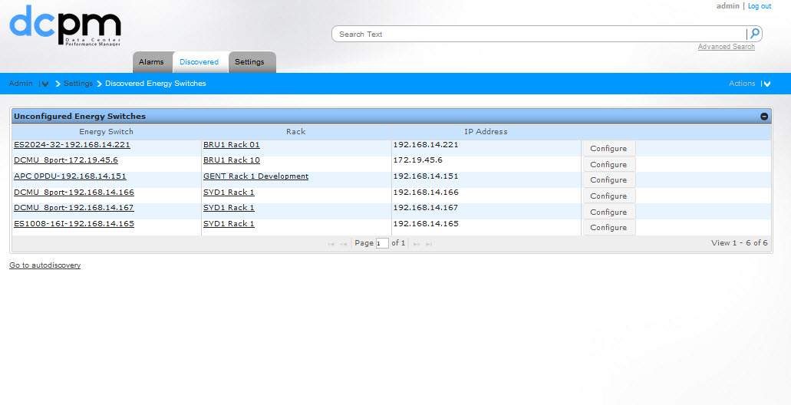
.DCPM adding devices
When devices are discovered credentials need to be configured for integration in DCPM.
DON’T COMPROMISE - reliable power management & environmental control
All content of this presentation is strictly confidential

Slide 11
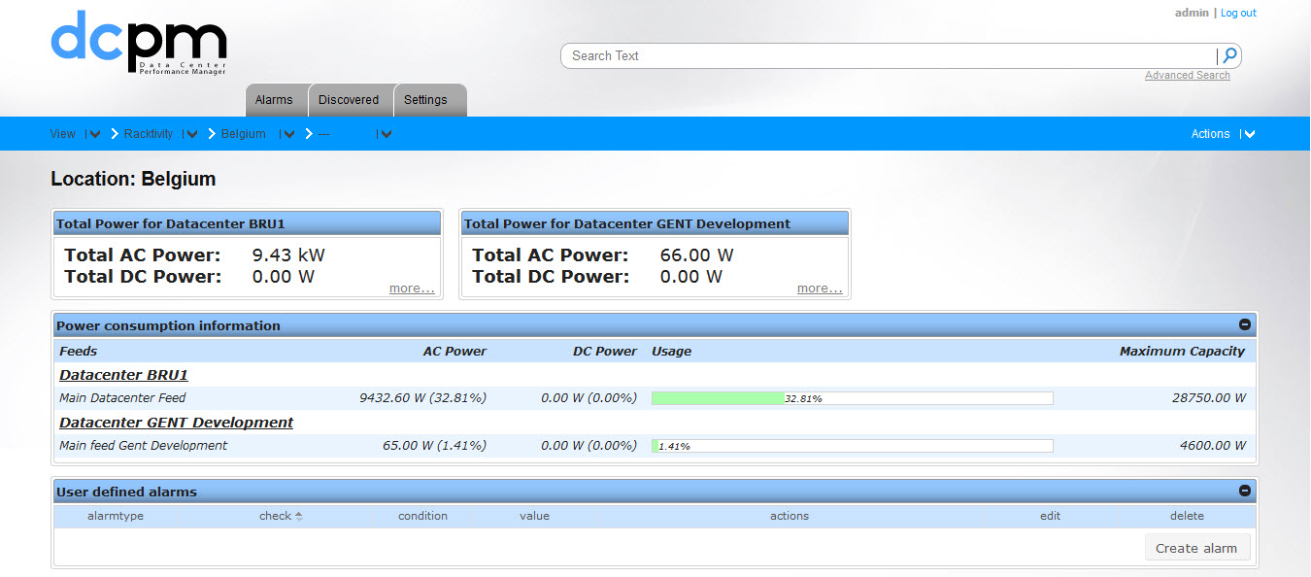
.DCPM capacity planning
Aggregated values are presented on the top layer of your enterprise structure and have an available drill down function.
DON’T COMPROMISE - reliable power management & environmental control
All content of this presentation is strictly confidential

Slide 12
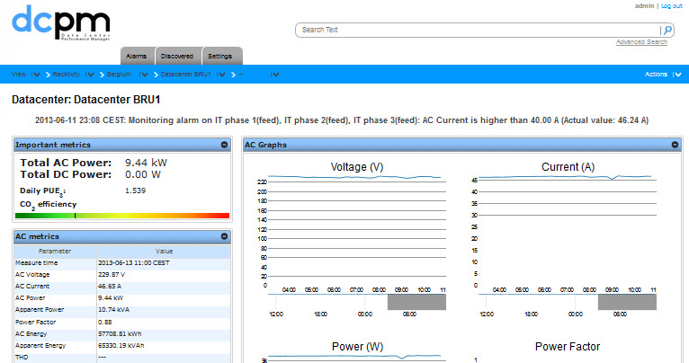
.DCPM datacenter
overview
When drilling down the structure, DCPM presents all aggregated values of the energy consumed in the datacenter.
Direct children of the stucture are presented when DCPM is using aggregated values.
When more detailed information is requested you can drill down further.
DON’T COMPROMISE - reliable power management & environmental control
All content of this presentation is strictly confidential

Slide 13
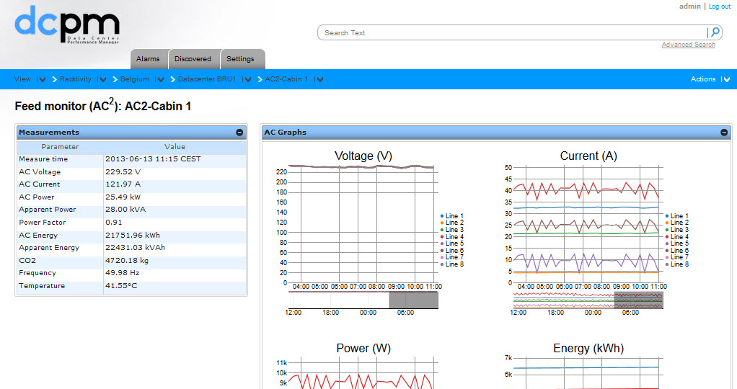
.DCPM datacenter
overview
When drilling down the structure to the most detailed point DCPM will present the values per outlet on the EnergySwitch and per inlet of the feed monitor (AC²Sensor).
A graphical representation is shown for the last 24 hours.
DON’T COMPROMISE - reliable power management & environmental control
All content of this presentation is strictly confidential

Slide 14
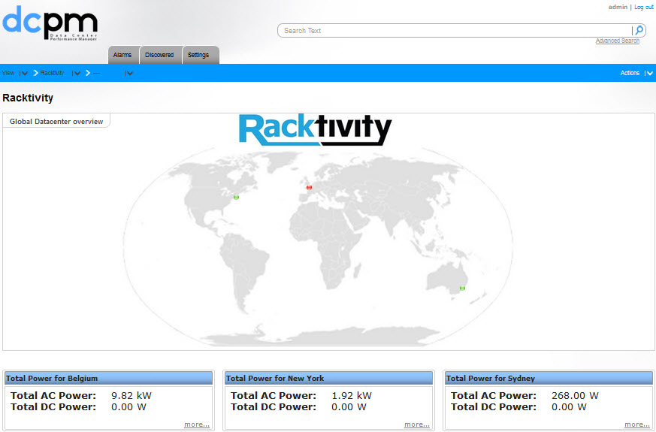
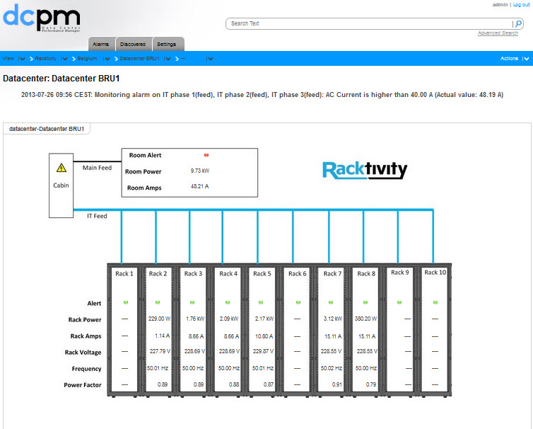
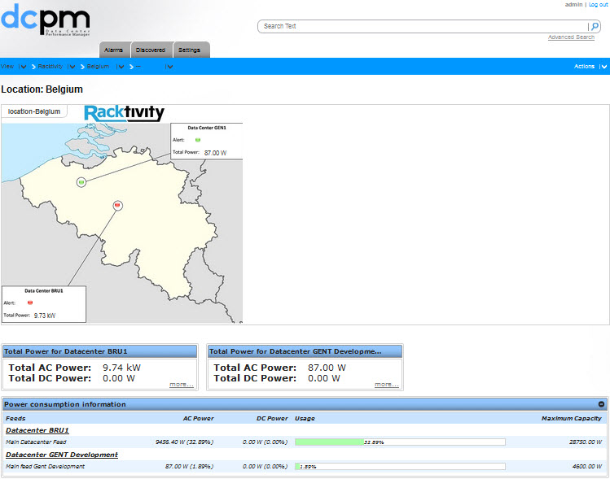
.DCPM overview through
maps
DCPM can present all measured information on graphical maps from a worldmap to country map, floorplan, rack,...
Graphical maps are uploaded in *.jpg and measured information/alerts can be added through drag and drop.
DON’T COMPROMISE - reliable power management & environmental control
All content of this presentation is strictly confidential

Slide 15
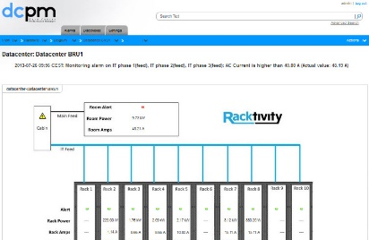
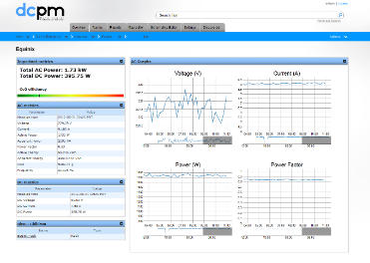

DON’T COMPROMISE - reliable power management & environmental control
All content of this presentation is strictly confidential

Slide 16
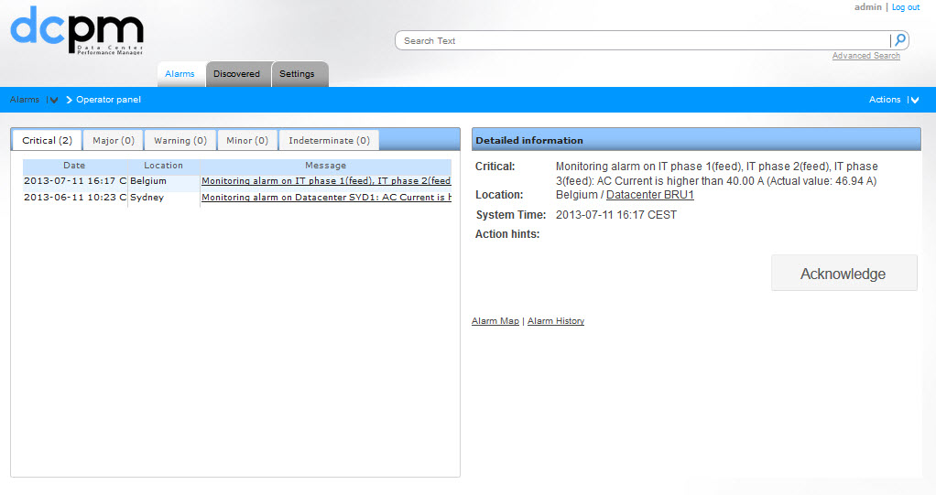
.DCPM alarm panel
On all items that are measured the user can set his own thresholds and add alerts if requested. Active alams are presented in an alarm panel.
Selecting an active alarm will provide the user with detailed information and action hints or procedures if those were set when setting the alarm.
DON’T COMPROMISE - reliable power management & environmental control
All content of this presentation is strictly confidential

Slide 17
.DCPM alarm panel
On all items that are measured the user can set his own tresholds and add alerts if requested. Active alams are presented in an alarm panel.
Pressing the active alarm will provide the user with detailed information and action hints or procedures if those were set when setting the alarm.
DCPM alarm history provides a complete overview of all alams that were made and acknowledged or automatically cleared.
DON’T COMPROMISE - reliable power management & environmental control
All content of this presentation is strictly confidential

Slide 18
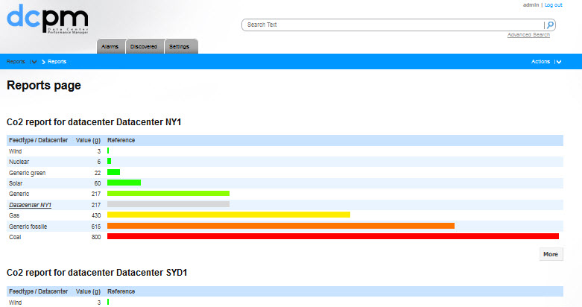
.DCPM reporting
DCPM provides standard reporting.
Customised reporting can be requested.
DON’T COMPROMISE - reliable power management & environmental control
All content of this presentation is strictly confidential

Slide 19
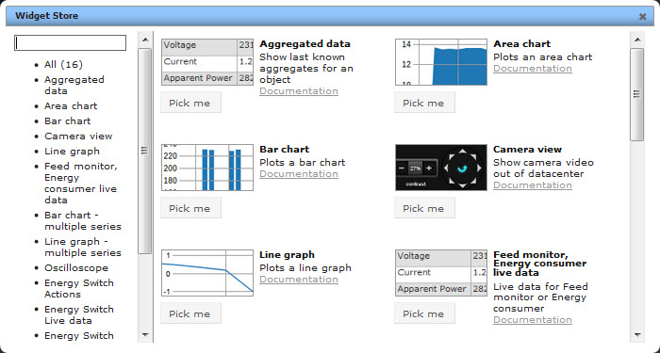
.DCPM widgets
DCPM widgets have the possibility to present data, cam view, web view, oscilloscope view and much more.
DON’T COMPROMISE - reliable power management & environmental control
All content of this presentation is strictly confidential

Slide 20
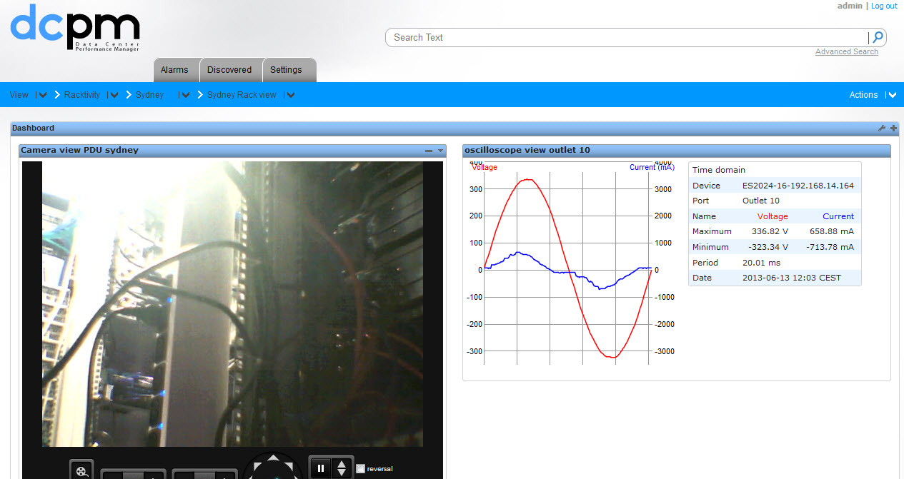
.DCPM widgets
DCPM widgets have the possibility to present data, cam view, web view, oscilloscope view and much more.
DON’T COMPROMISE - reliable power management & environmental control
All content of this presentation is strictly confidential

Slide 21
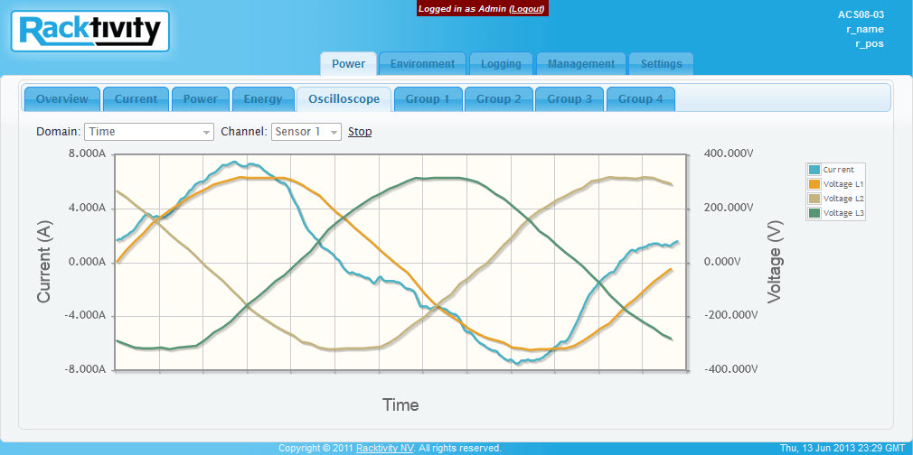
.DCPM widgets
DCPM widgets can have access to the GUI of the device presenting real time osciloscope view and other data.
DON’T COMPROMISE - reliable power management & environmental control
All content of this presentation is strictly confidential

Slide 22
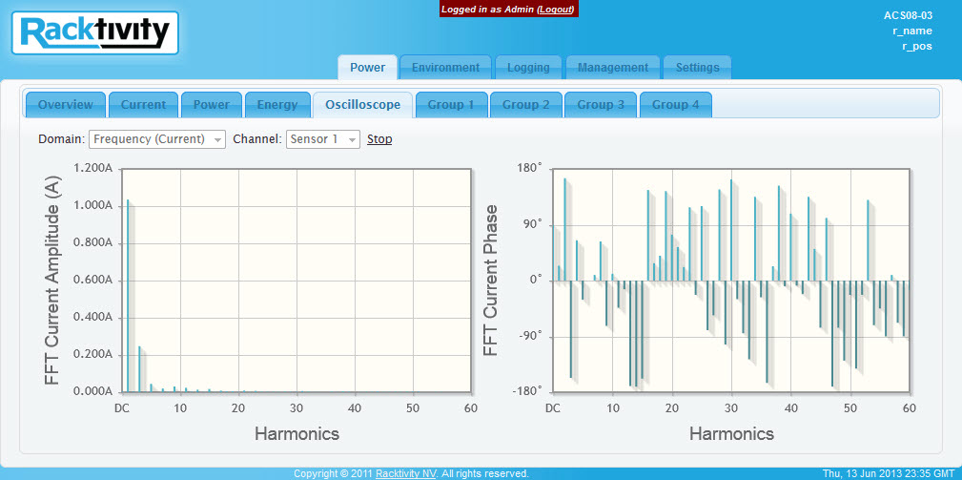
.Harmonics
DCPM widgets can have access to the GUI of the device presenting real time harmonics and phase shifting.
DON’T COMPROMISE - reliable power management & environmental control
All content of this presentation is strictly confidential

Slide 23
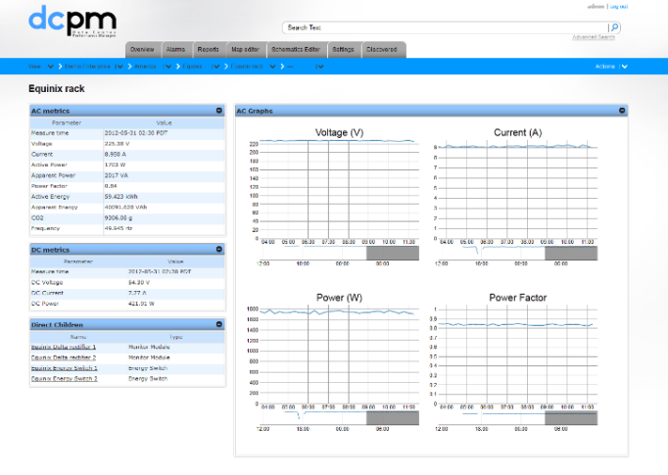
.DCPM training v1.3.3
Extended training can be requested
Detailed set up and monitoring
User Management
Reporting
Alarms
...
DON’T COMPROMISE - reliable power management & environmental control
All content of this presentation is strictly confidential

Slide 24
Thank you
Lesley Zonnekein
Technical Pre-Sales
Lesley.zonnekein@racktivity.com
www.racktivity.com
DON’T COMPROMISE - reliable power management & environmental control
All content of this presentation is strictly confidential

